Slide 1
Exploratory Data Analysis

Slide 2

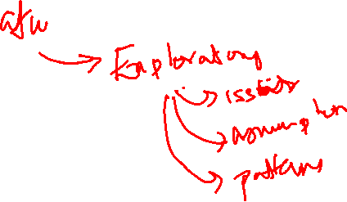

Slide 3
Exploratory Data Analysis (EDA)
Descriptive Statistics
Graphical
Data driven
Confirmatory Data Analysis (CDA)
Inferential Statistics
EDA and theory driven

Slide 4
Before you begin your analyses, it is imperative that you examine all your variables.
Why?
To listen to the data:
-to catch mistakes
-to see patterns in the data
-to find violations of statistical assumptions
…and because if you don’t, you will have trouble later

Slide 5
Overview
Part I:
The Basics
or
“I got mean and deviant and now I’m considered normal”
Part II:
Exploratory Data Analysis
or
“I ask Skew how to recover from kurtosis and only hear ‘Get out, liar!’”

Slide 6
What is data?
Categorical (Qualitative)
    Nominal scales – number is just a symbol that identifies a quality
      0=male, 1=female
      1=green, 2=blue, 3=red, 4=white
    Ordinal – rank order
Quantitative (continuous and discrete)
    Interval – units are of identical size (i.e. Years)
    Ratio – distance from an absolute zero (i.e. Age, reaction time)

Slide 7
What is a measurement?
Every measurement has 2 parts:
The True Score (the actual state of things in the world)
and
ERROR! (mistakes, bad measurement, report bias, context effects, etc.)
X = T + e

Slide 8
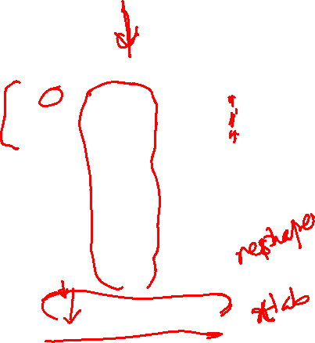
Organizing your data in a spreadsheet
Stacked data:
Multiple cases (rows) for each subject
Unstacked data:
Only one case (row) per subject
Subject | condition | score
1 | before | 3
1 | during | 2
1 | after | 5
2 | before | 3
2 | during | 8
2 | after | 4
3 | before | 3
3 | during | 7
3 | after | 1
Subject | before | during | after
1 | 3 | 2 | 5
2 | 3 | 8 | 4
3 | 3 | 7 | 1

Slide 9
Variable Summaries
Indices of central tendency:
  Mean – the average value
  Median – the middle value
  Mode – the most frequent value
Indices of Variability:
  Variance – the spread around the mean
  Standard deviation
  Standard error of the mean (estimate)

Slide 10
The Mean
Subject | before | during | after
1 | 3 | 2 | 7
2 | 3 | 8 | 4
3 | 3 | 7 | 3
4 | 3 | 2 | 6
5 | 3 | 8 | 4
6 | 3 | 1 | 6
7 | 3 | 9 | 3
8 | 3 | 3 | 6
9 | 3 | 9 | 4
10 | 3 | 1 | 7
Mean = sum of all scores divided by number of scores
X₁ + X₂ + X₃ + …. X_{n}
n
mean and median applet
Sum = 30 50 50
/n 10 10 10
Mean = 3 5 5

Slide 11
The Variance: Sum of the squared deviations divided by number of scores
Subject | before | during | after
1 | 3 | 2 | 7
2 | 3 | 8 | 4
3 | 3 | 7 | 3
4 | 3 | 2 | 6
5 | 3 | 8 | 4
6 | 3 | 1 | 6
7 | 3 | 9 | 3
8 | 3 | 3 | 6
9 | 3 | 9 | 4
10 | 3 | 1 | 7
Before -mean | Before – mean ² | During - mean | During – mean² | After - mean | After – mean ²
0 | 0 | -3 | 9 | 2 | 4
0 | 0 | 3 | 9 | -1 | 1
0 | 0 | 2 | 4 | -2 | 4
0 | 0 | -3 | 9 | 1 | 1
0 | 0 | 3 | 9 | -1 | 1
0 | 0 | -4 | 16 | 1 | 1
0 | 0 | 4 | 16 | -2 | 4
0 | 0 | -2 | 4 | 1 | 1
0 | 0 | 4 | 16 | -1 | 1
0 | 0 | -4 | 16 | 2 | 4
Sum = 30 50 50
/n 10 10 10
Mean = 3 5 5
0 0 0 108 0 22
10* 10 10
VAR = 0 10.8 2.2
*actually you divide by n-1 because it is a sample and not a population, but you get the idea…

Slide 12
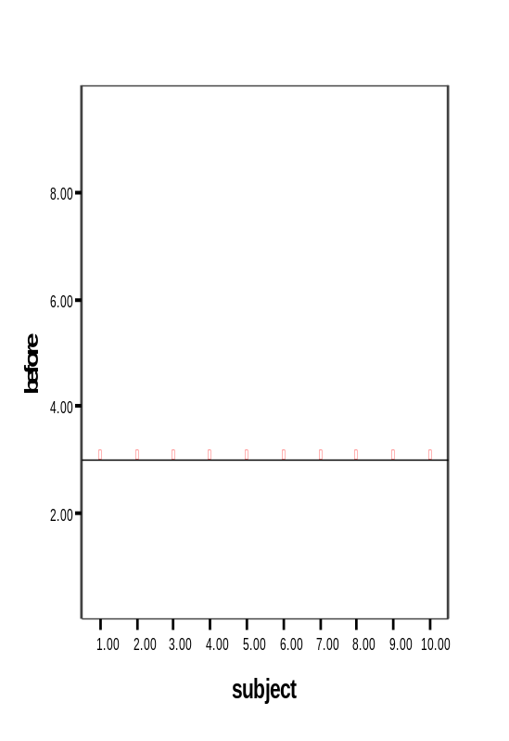
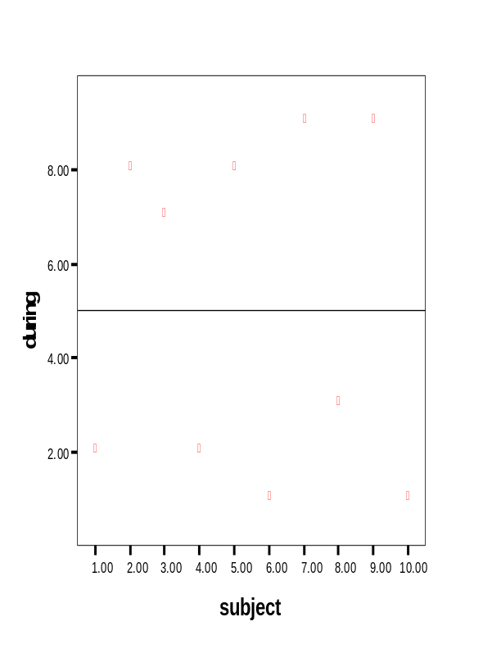
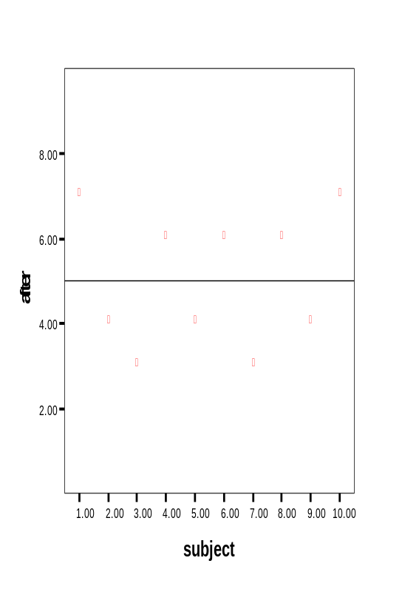
Variance continued
mean

Slide 13
Distribution
Means and variances are ways to describe a distribution of scores.
Knowing about your distributions is one of the best ways to understand your data
A NORMAL (aka Gaussian) distribution is the most common assumption of statistics, thus it is often important to check if your data are normally distributed.
Normal Distribution applet normaldemo.html sorry, these don’t work yet

Slide 14
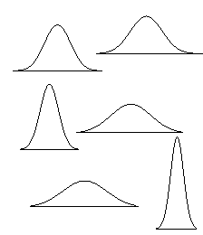
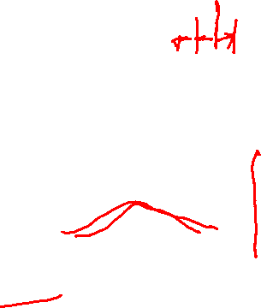
What is “normal” anyway?
With enough measurements, most variables are distributed normally
But in order to fully describe data we need to introduce the idea of a standard deviation
leptokurtic
platokurtic

Slide 15
Standard deviation
Variance, as calculated earlier, is arbitrary.
What does it mean to have a variance of 10.8? Or 2.2? Or 1459.092? Or 0.000001?
Nothing. But if you could “standardize” that value, you could talk about any variance (i.e. deviation) in equivalent terms.
Standard Deviations are simply the square root of the variance

Slide 16
Standard deviation
The process of standardizing deviations goes like this:
1.Score (in the units that are meaningful)
2.Mean
3.Each score’s deviation from the mean
4.Square that deviation
5.Sum all the squared deviations (Sum of Squares)
6.Divide by n (if population) or n-1 (if sample)
7.Square root – now the value is in the units we started with!!!

Slide 17
Interpreting standard deviation (SD)
First, the SD will let you know about the distribution of scores around the mean.
High SDs (relative to the mean) indicate the scores are spread out
Low SDs tell you that most scores are very near the mean.
High SD
Low SD

Slide 18
Interpreting standard deviation (SD)
Second, you can then interpret any individual score in terms of the SD.
For example: mean = 50, SD = 10
versus mean = 50, SD = 1
A score of 55 is:
0.5 Standard deviation units from the mean (not much) OR
5 standard deviation units from mean (a lot!)

Slide 19
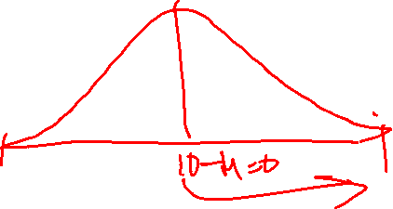
Standardized scores (Z)
Third, you can use SDs to create standardized scores – that is, force the scores onto a normal distribution by putting each score into units of SD.
Subtract the mean from each score and divide by SD
Z = (X – mean)/SD
This is truly an amazing thing

Slide 20
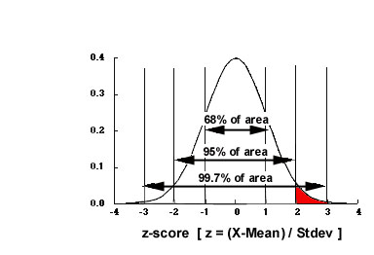
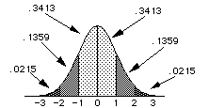
Standardized normal distribution
ALL Z-scores have a mean of 0 and SD of 1. Nice and simple.
From this we can get the proportion of scores anywhere in the distribution.

Slide 21
The trouble with normal
We violate assumptions about statistical tests if the distributions of our variables are not approximately normal.
Thus, we must first examine each variable’s distribution and make adjustments when necessary so that assumptions are met.
sample mean applet not working yet

Slide 22
Part II
Examine every variable for:
Out of range values
Normality
Outliers

Slide 23

Checking data
In SPSS, you can get a table of each variable with each value and its frequency of occurrence.
You can also compute a checking variable using the COMPUTE command. Create a new variable that gives a 1 if a value is between minimum and maximum, and a 0 if the value is outside that range.
Best way to examine categorical variables is by checking their frequencies

Slide 24
Visual display of univariate data
Now the example data from before has decimals
(what kind of data is that?)
Precision has increased
Subject | before | during | after
1 | 3.1 | 2.3 | 7
2 | 3.2 | 8.8 | 4.2
3 | 2.8 | 7.1 | 3.2
4 | 3.3 | 2.3 | 6.7
5 | 3.3 | 8.6 | 4.5
6 | 3.3 | 1.5 | 6.6
7 | 2.8 | 9.1 | 3.4
8 | 3 | 3.3 | 6.5
9 | 3.1 | 9.5 | 4.1
10 | 3 | 1 | 7.3

Slide 25
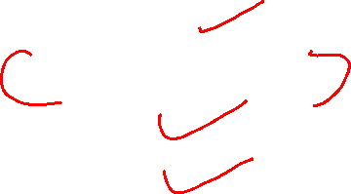
Visual display of univariate data
Histograms
Stem and Leaf plots
Boxplots
QQ Plots
…and many many more
Subject | before | during | after
1 | 3.1 | 2.3 | 7
2 | 3.2 | 8.8 | 4.2
3 | 2.8 | 7.1 | 3.2
4 | 3.3 | 2.3 | 6.7
5 | 3.3 | 8.6 | 4.5
6 | 3.3 | 1.5 | 6.6
7 | 2.8 | 9.1 | 3.4
8 | 3 | 3.3 | 6.5
9 | 3.1 | 9.5 | 4.1
10 | 3 | 1 | 7.3

Slide 26
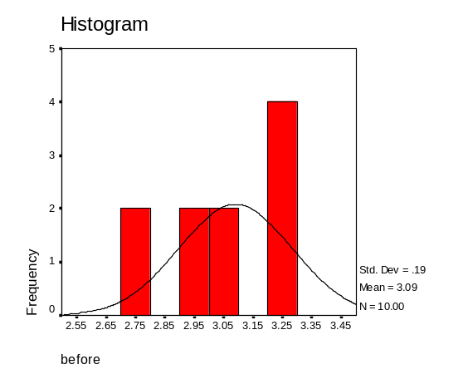
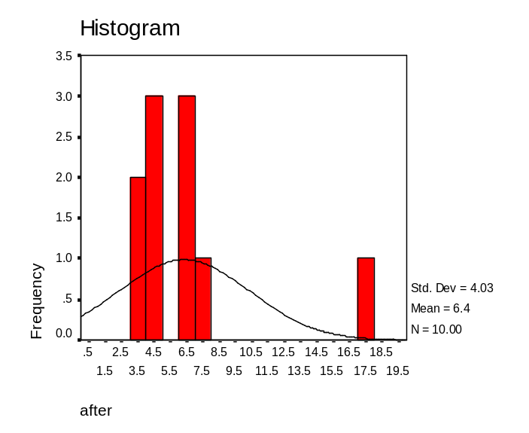

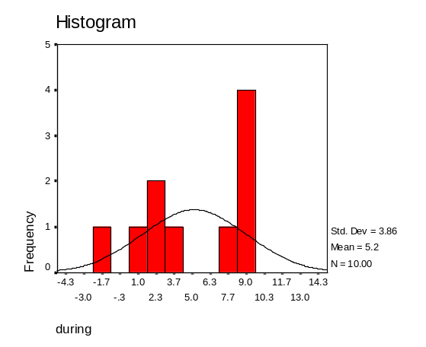
Histograms
# of bins is very important: Histogram applet

Slide 27
Stem and Leaf plots
Before:
N = 10 Median = 3.1 Quartiles = 3, 3.3
2 : 88
3 : 00112333
During:
N = 10 Median = 5.2 Quartiles = 2.3, 8.8
-1 : 0
-0 :
0 :
1 : 5
2 : 33
3 : 3
4 :
5 :
6 :
7 : 1
8 : 68
9 : 15
After:
N = 10 Median = 5.5 Quartiles = 4.1, 6.7
3 : 24
4 : 125
5 :
6 : 567
7 : 3
High: 17

Slide 28
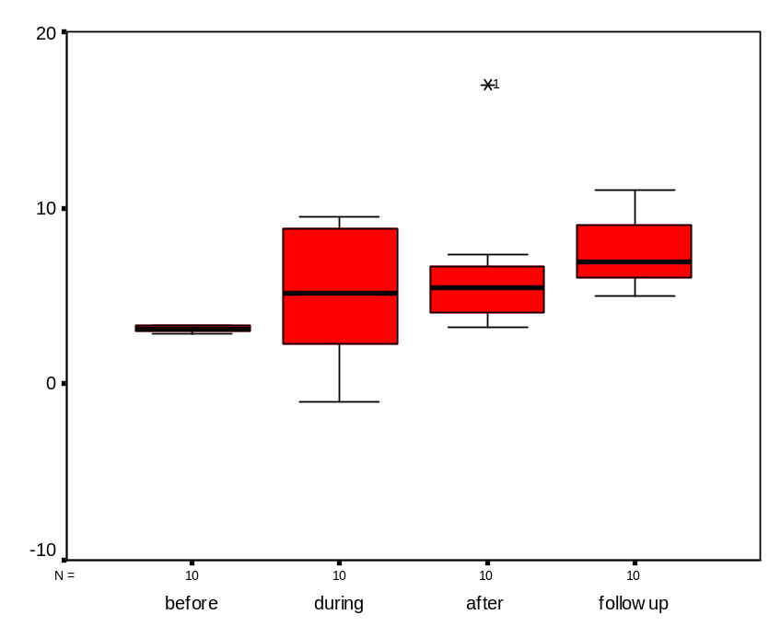
Boxplots
Upper and lower bounds of boxes are the 25th and 75th percentile (interquartile range)
Whiskers are min and max value unless there is an outlier
An outlier is beyond 1.5 times the interquartile range (box length)

Slide 29
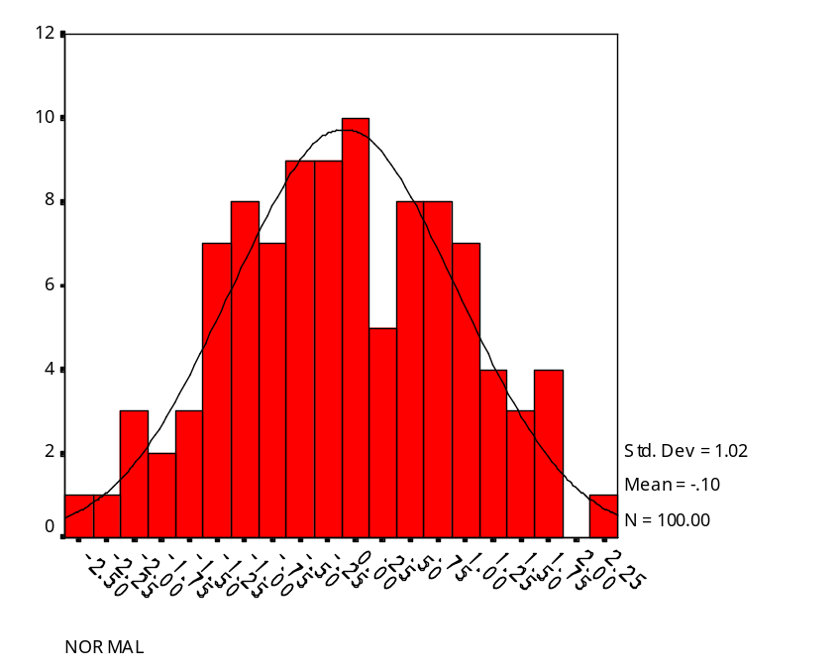
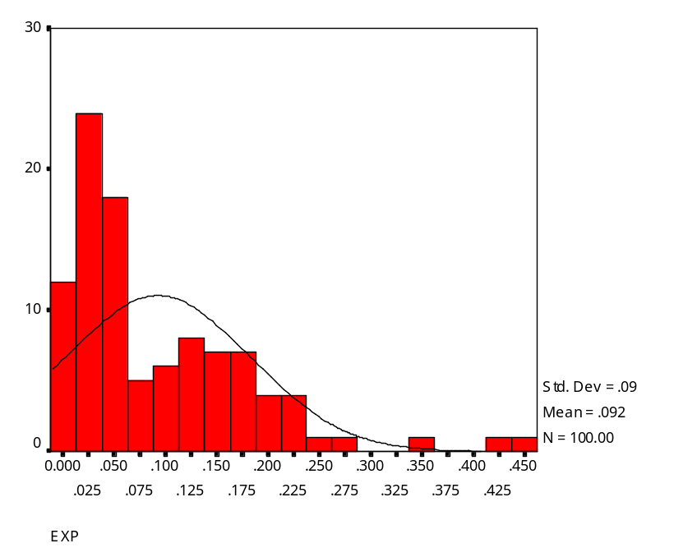
Quantile-Quantile (Q-Q) Plots
Random Normal Distribution Random Exponential Distribution

Slide 30
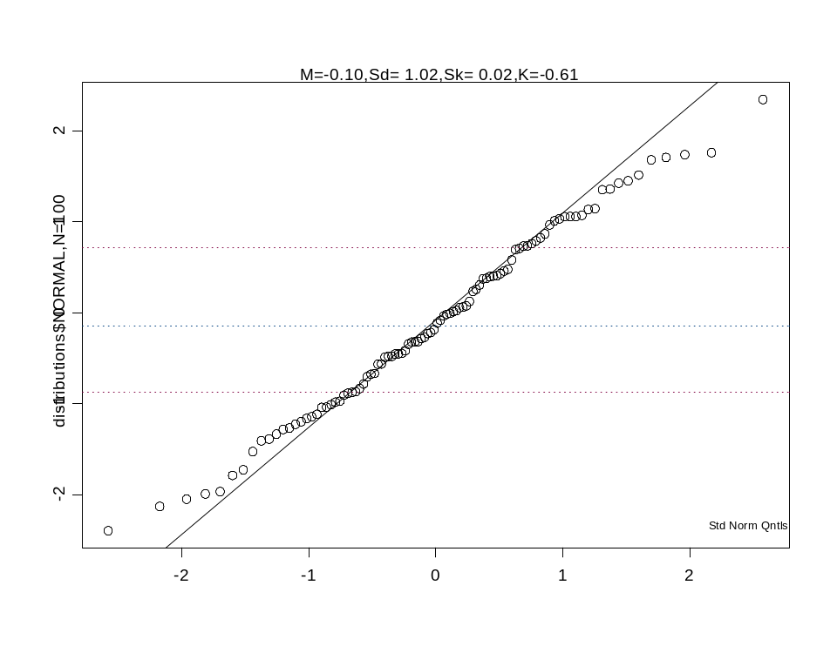
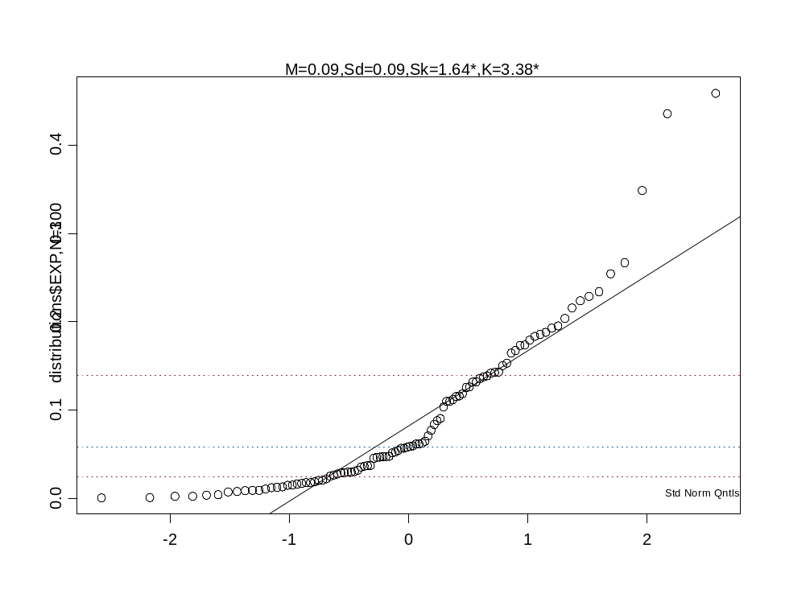
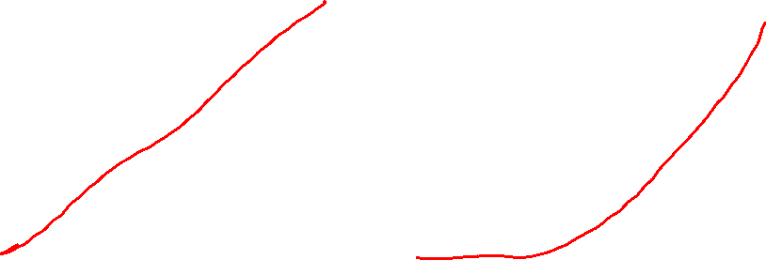
Q-Q Plots

Slide 31
So…what do you do?
If you find a mistake, fix it.
If you find an outlier, trim it or delete it.
If your distributions are askew, transform the data.

Slide 32

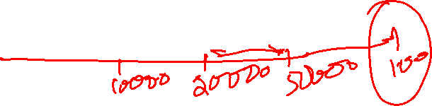
Dealing with Outliers
First, try to explain it.
In a normal distribution 0.4% are outliers (>2.7 SD) and 1 in a million is an extreme outlier (>4.72 SD).
For analyses you can:
Delete the value – crude but effective
Change the outlier to value ~3 SD from mean
“Winsorize” it (make = to next highest value)
“Trim” the mean – recalculate mean from data within interquartile range

Slide 33
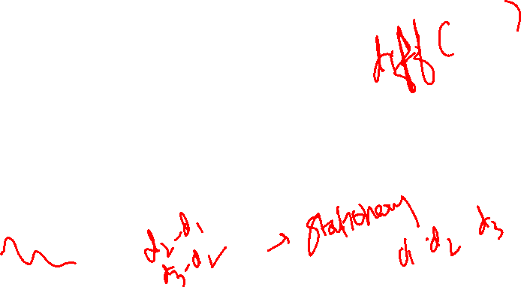
Dealing with skewed distributions
(Skewness and kurtosis greater than +/- 2)
Negative skew is reduced by squaring the data values
Positive skew is reduced by using the square root or log

Slide 34
Visual Display of Bivariate Data
So, you have examined each variable for mistakes, outliers and distribution and made any necessary alterations. Now what?
Look at the relationship between 2 (or more) variables at a time

Slide 35
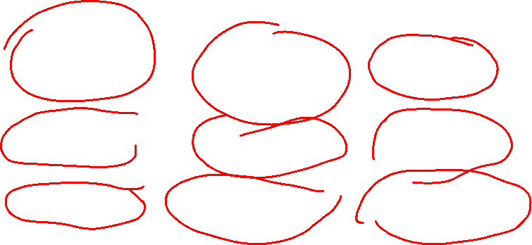
Visual Displays of Bivariate Data
Variable 1 | Variable 2 | Display Example
Categorical | Categorical | Crosstabs
Categorical | Continuous | Box plots
Continuous | Continuous | Scatter plots

Slide 36
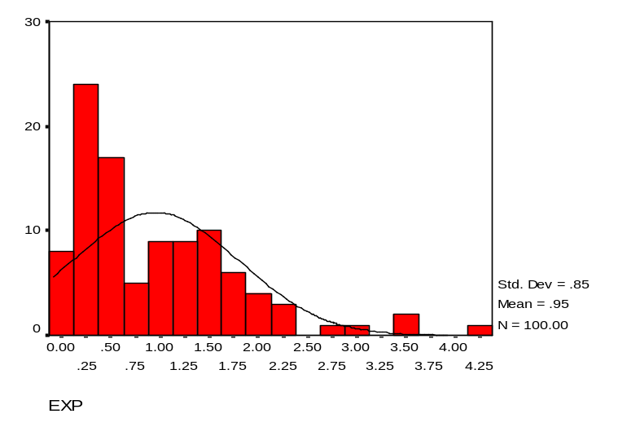
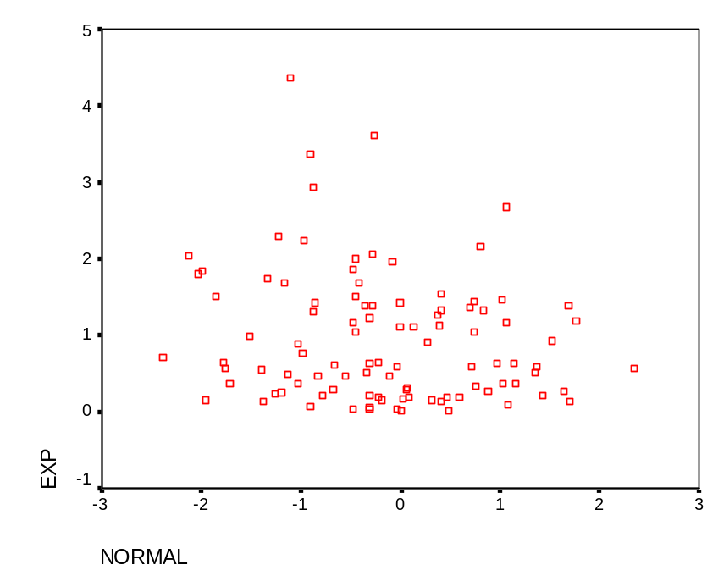
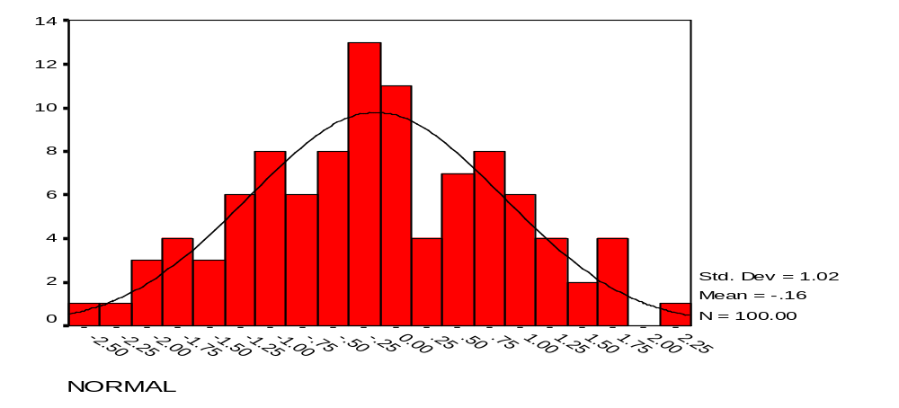
Bivariate Distribution

Slide 37
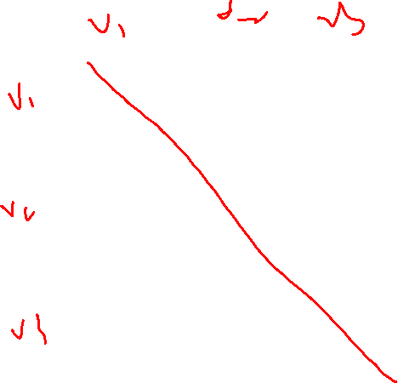
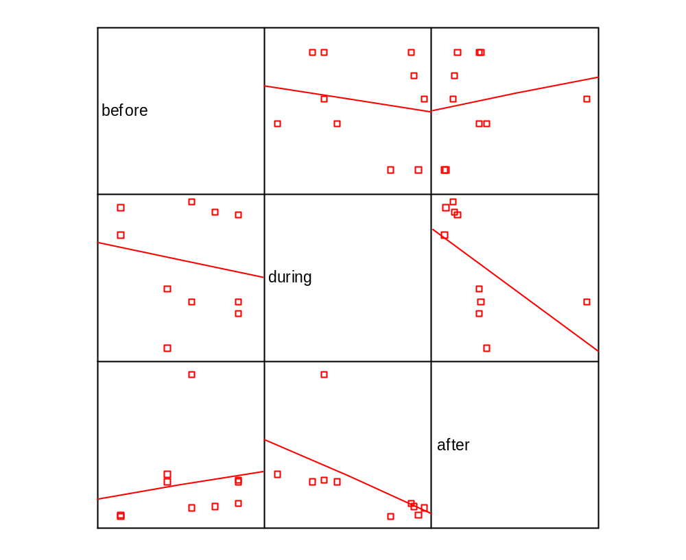
Intro to Scatter plots
Correlation and Regression Applet

Slide 38
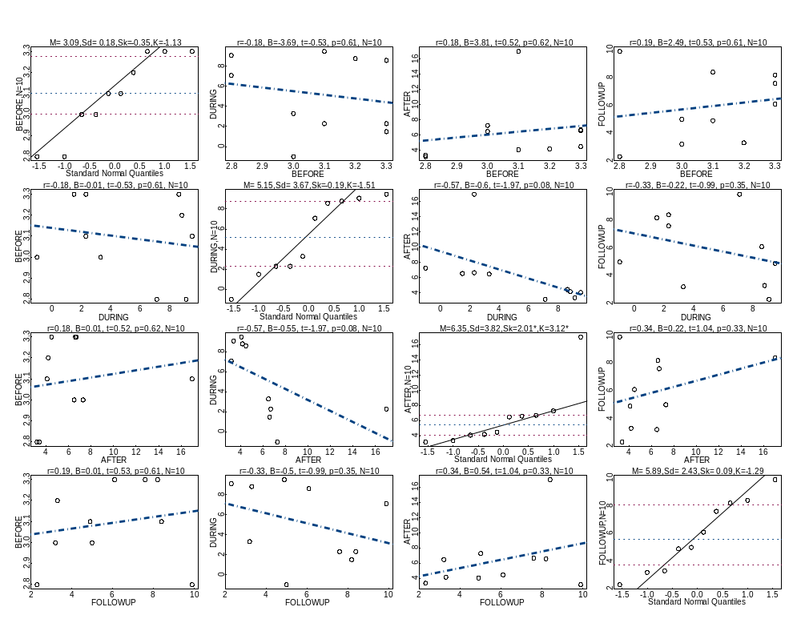

Slide 39
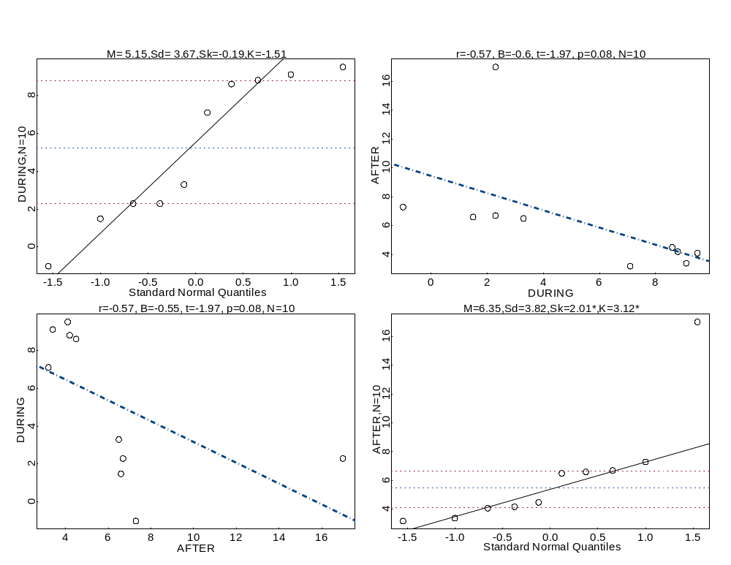
With Outlier and Out of Range Value

Slide 40
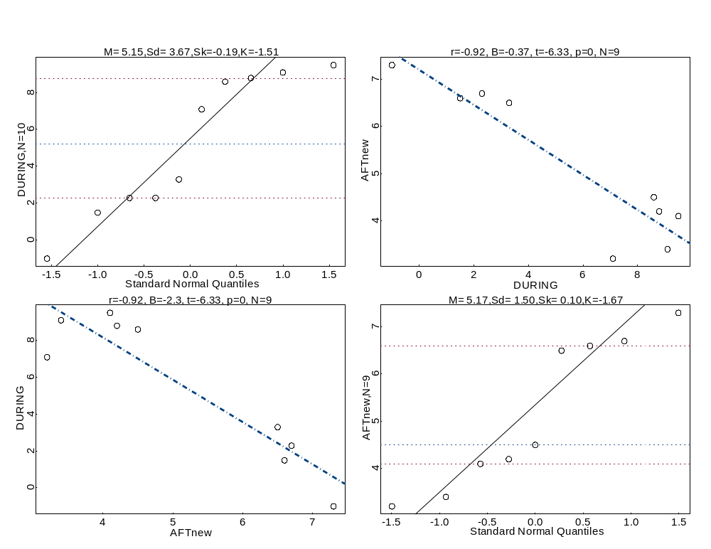
Without Outlier

Slide 41
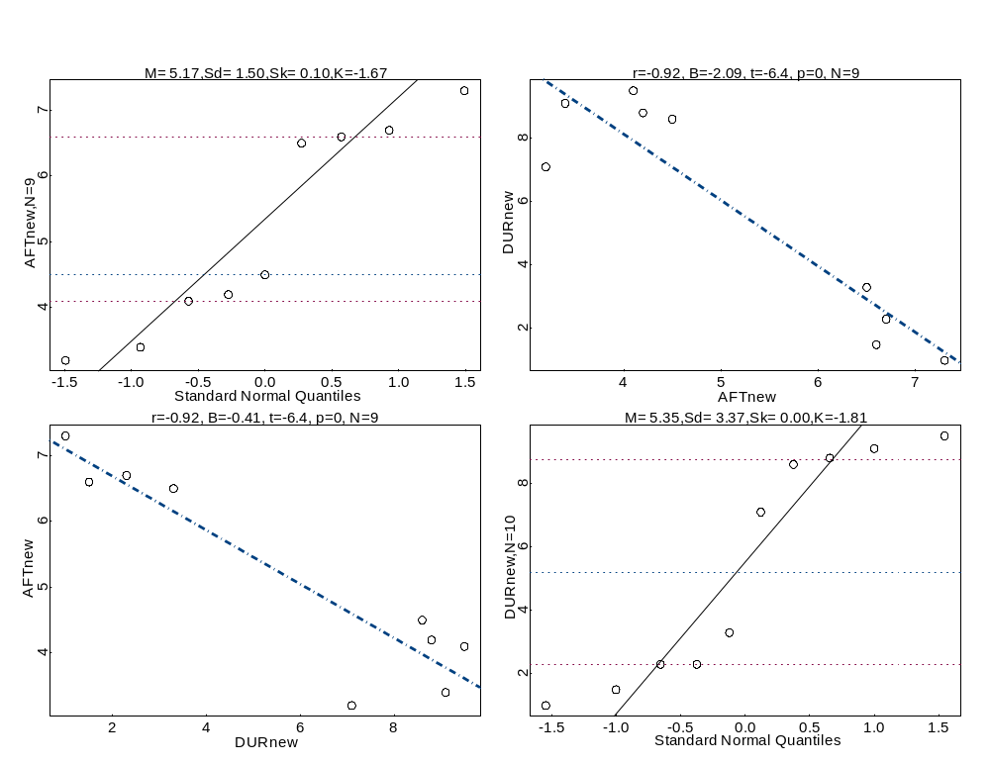
With Corrected Out of Range Value

Slide 42
Scales of Graphs
It is very important to pay attention to the scale that you are using when you are plotting.
Compare the following graphs created from identical data

Slide 43
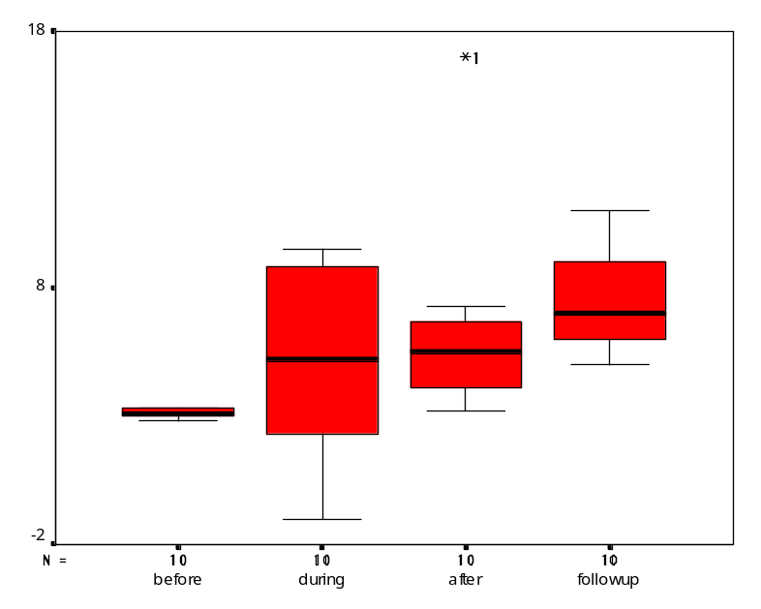
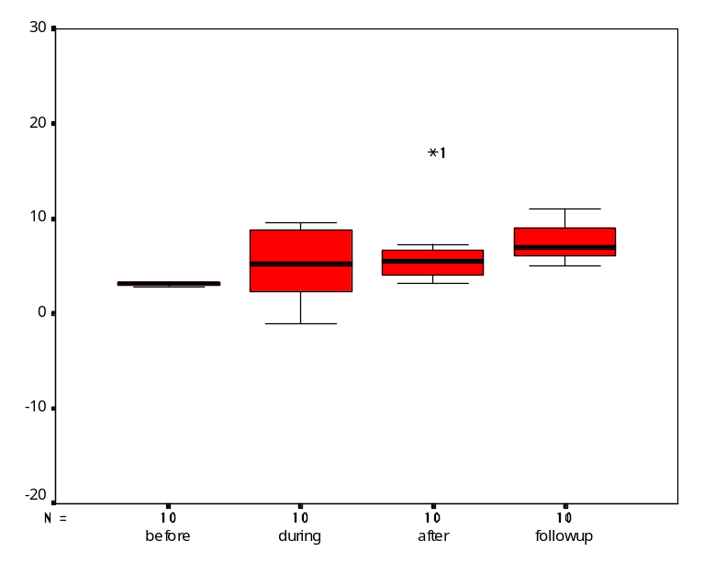

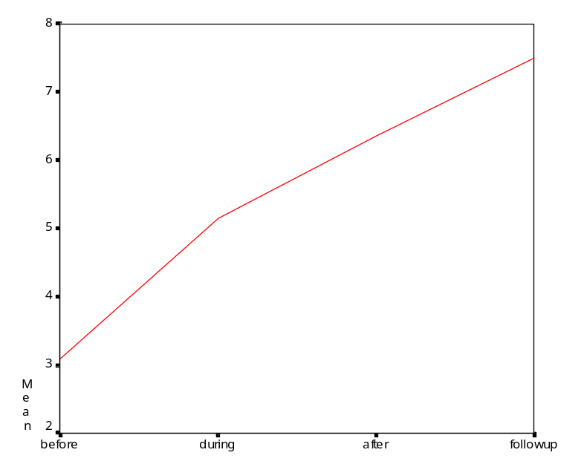
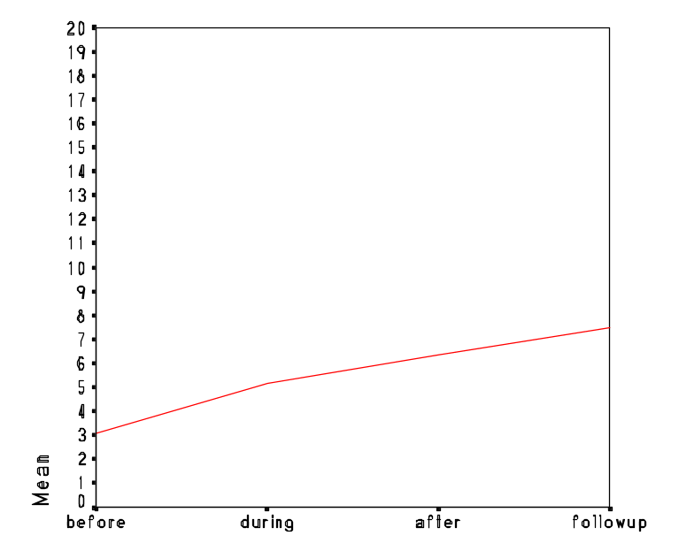

Slide 44
Summary
Examine all your variables thoroughly and carefully before you begin analysis
Use visual displays whenever possible
Transform each variable as necessary to deal with mistakes, outliers, and distributions

Slide 45
Resources on line
http://www.statsoftinc.com/textbook/stathome.html
http://www.cs.uni.edu/~campbell/stat/lectures.html
http://www.psychstat.smsu.edu/sbk00.htm
http://davidmlane.com/hyperstat/
http://bcs.whfreeman.com/ips4e/pages/bcs-main.asp?v=category&s=00010&n=99000&i=99010.01&o=
http://trochim.human.cornell.edu/selstat/ssstart.htm
http://www.math.yorku.ca/SCS/StatResource.html#DataVis

Slide 46







































Slide 47
Recommended Reading
Anything by Tukey, especially Exploratory Data Analysis (Tukey, 1997)
Anything by Cleveland, especially Visualizing Data (Cleveland, 1993)
Visual Display of Quantitative Information (Tufte, 1983)
Anything on statistics by Jacob Cohen or Paul Meehl.

Slide 48
for next time
http://www.execpc.com/~helberg/pitfalls

Slide 49
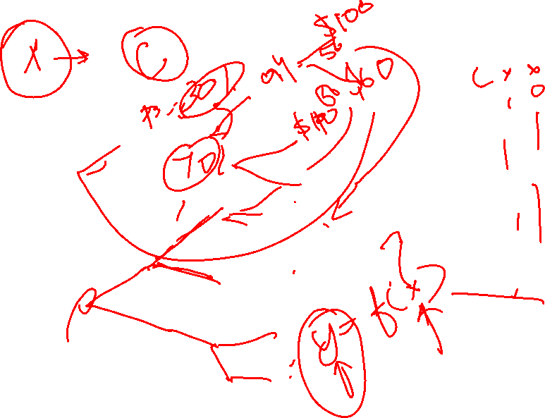
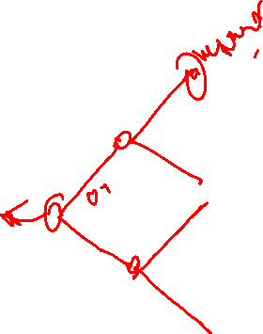

Slide 50
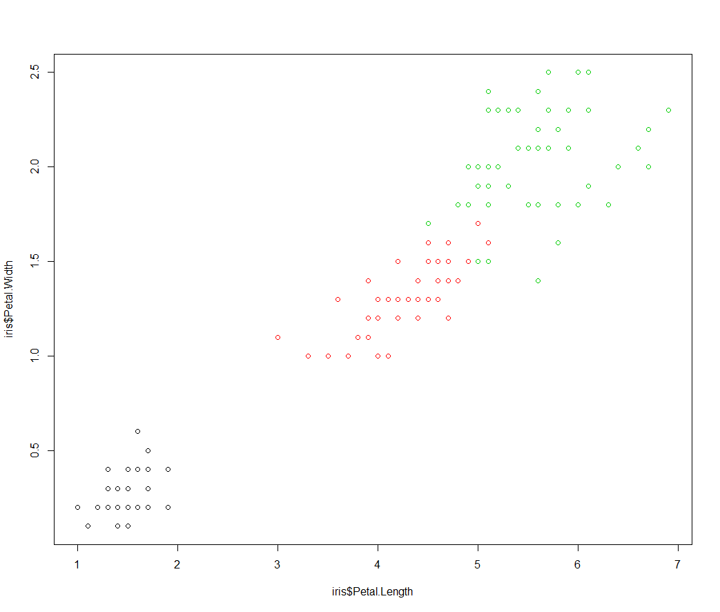
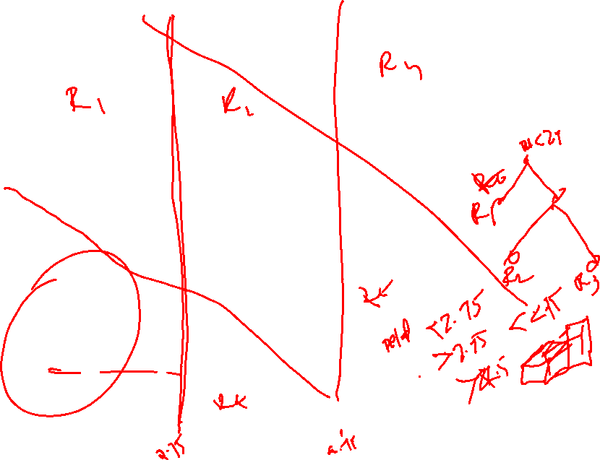

Slide 51
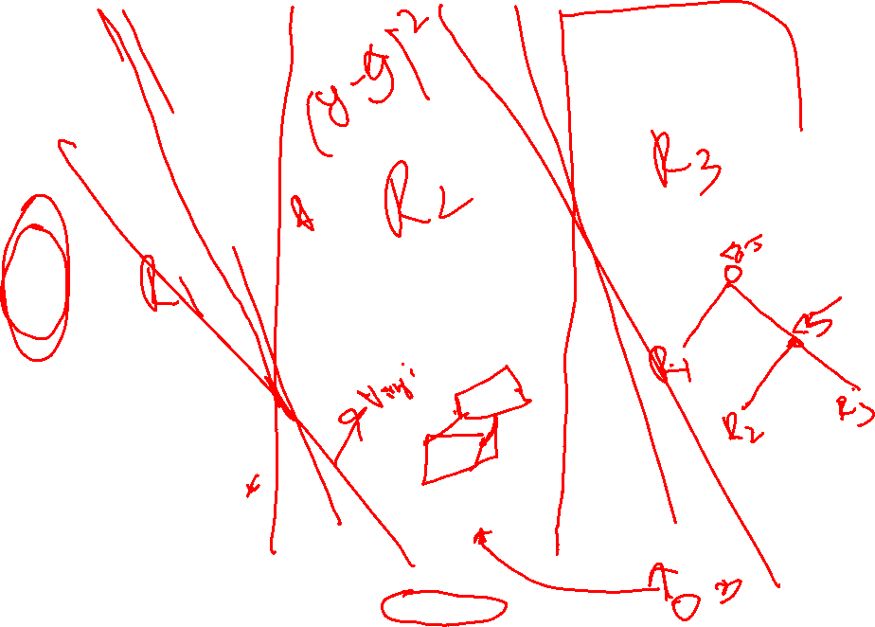

Slide 52
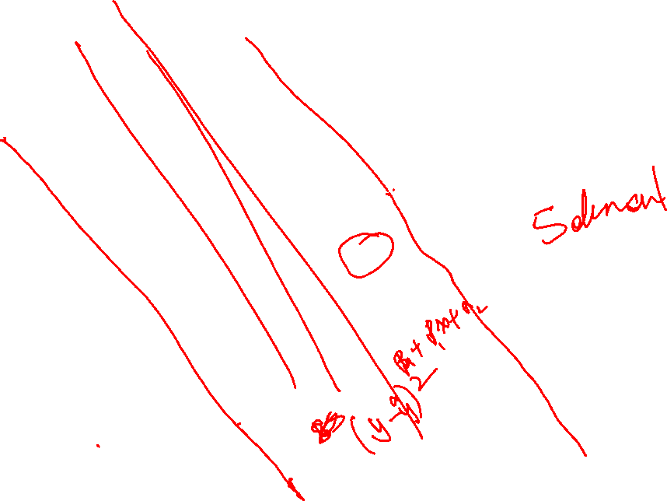

Slide 53
Tree-based Methods
Stratifying or segmenting the predictor space into a number of simple regions
Central tendencies
Regression and Classification

Slide 54
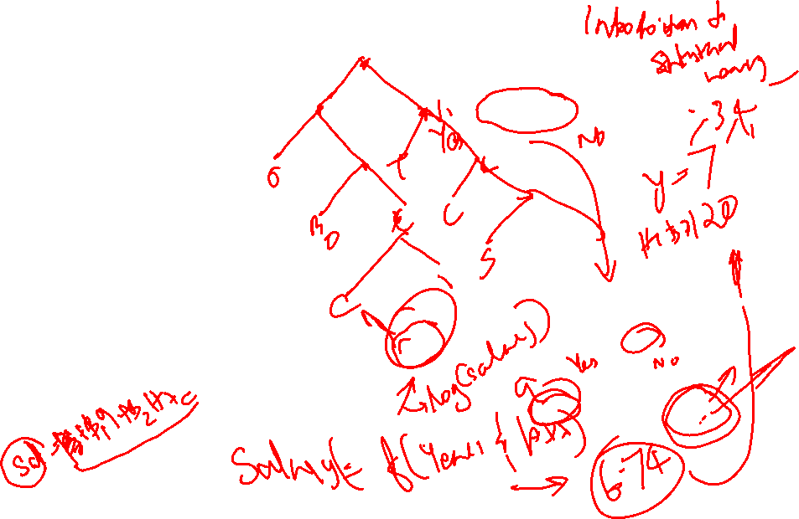
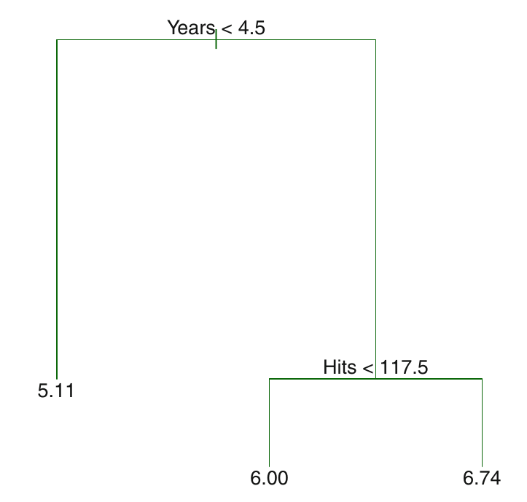
Prediction via Stratification of the Feature Space
We divide the predictor space—that is, the set of possible values for X1, X2, . . . , Xp—into J distinct and non-overlapping regions, R1 , R2 , . . . , RJ .
For every observation that falls into the region Rj , we make the same prediction, which is simply the mean of the response values for the training observations in Rj .

Slide 55
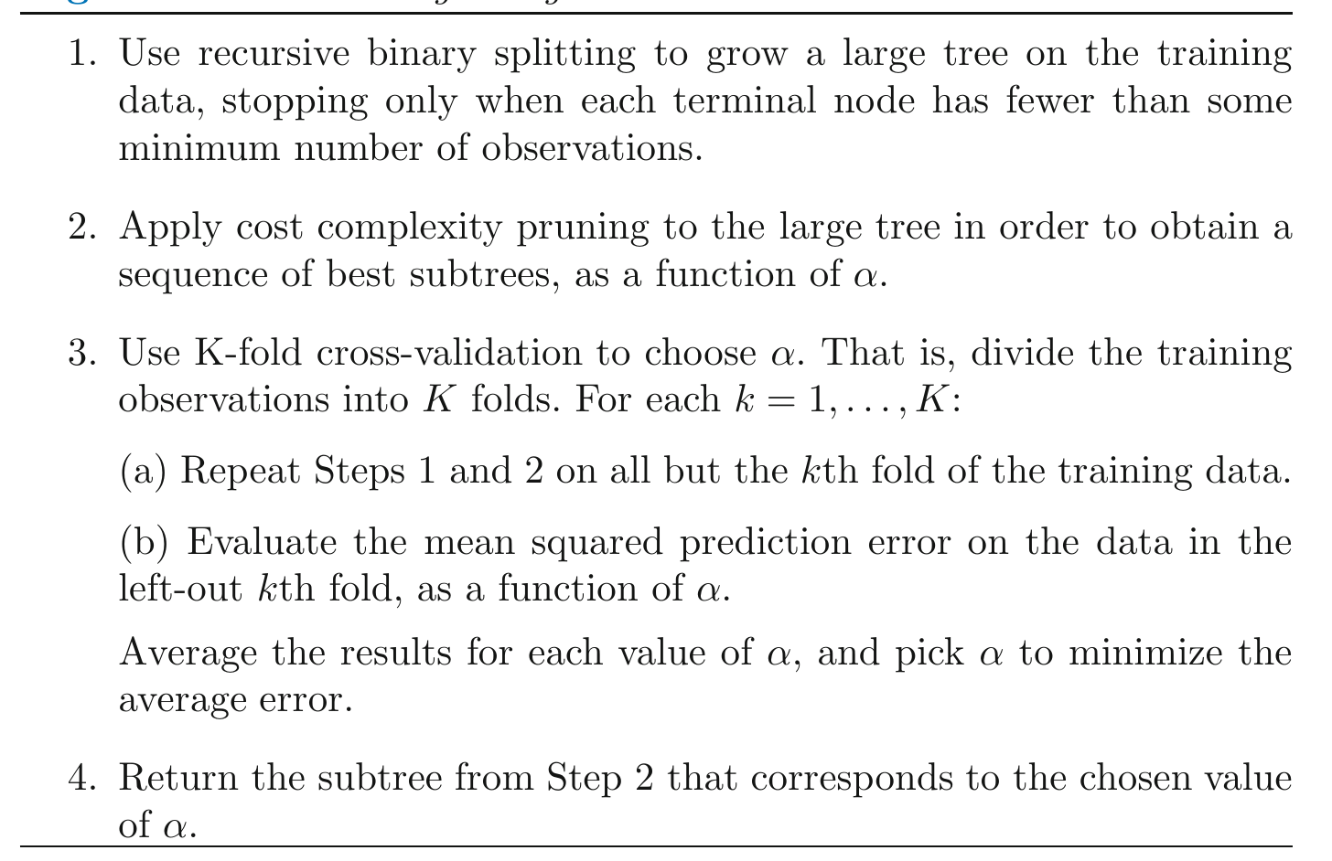
Regression Tree

